Slide 1












Tactical
Sandbox

Slide 2
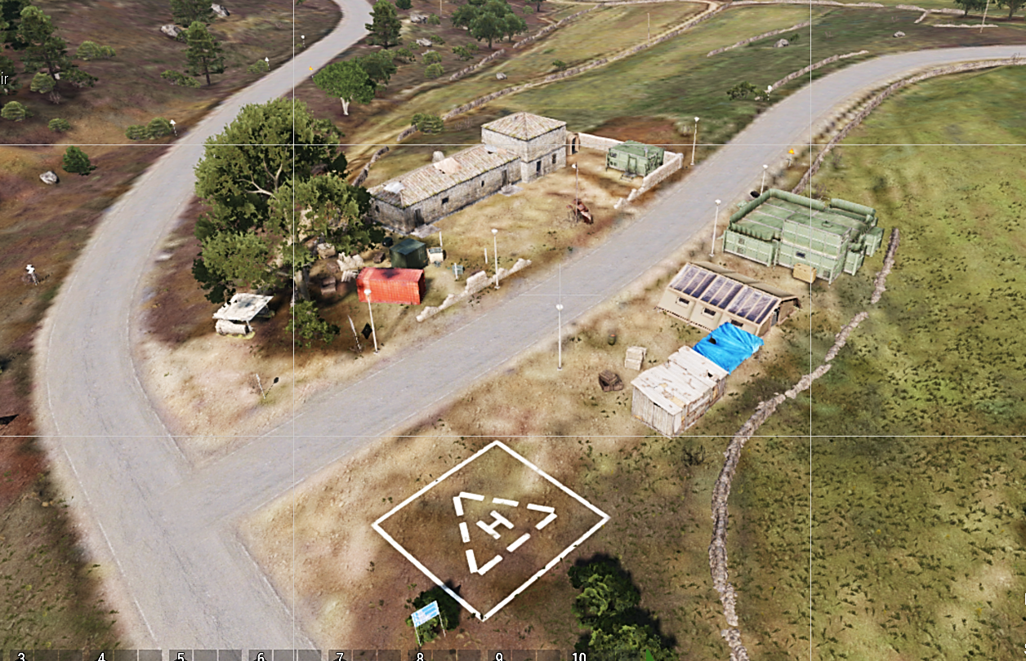
2
1
3
4
6
5

